Slide 1
Employee Data Analysis using Excel
STUDENT NAME: VIDHYA P
REGISTER NO: 312209873
NAAN MUDHALVAN ID:asunm1363312209873
DEPARTMENT:B.COM (ACCOUNTING AND FINANCE)
COLLEGE: VALLIAMMAL COLLEGE FOR WOMEN

Slide 2
PROJECT TITLE
Employee Performance Analysis using Excel

Slide 3


AGENDA
Problem Statement
Project Overview
End Users
Our Solution and Proposition
Dataset Description
Modelling Approach
Results and Discussion
Conclusion
3/21/2024 Annual Review

Slide 4

PROBLEM STATEMENT
To Provide an Employee data analysis summary,
I”II need to outline a few common problem statement and how they can be addressed through analysis. Below are example of potential problem statement and the corresponding analyses that might be conducted:
Employee Engagement and Productivity
Workforce Diversity and Inclusion
Skill Gap Analysis
Compensation and Benefits Optimization
Improving Employee Retention through Career Development
High Employee Turnover Rate
Workforce Planning and Optimization.
For each Problem statement, the analysis typically involves data collection ,statistical analysis, often the use of advanced analytics techniques like predictive modeling or machine learning. The insights derived from these analyses are then used to inform decision-making and strategy development.

Slide 5

PROJECT OVERVIEW
To help you create an employee data summary for a project overview, I’II need more details. Could you provide the following information.
This project focuses on analyzing employee data to identify trends and insights that can drive better decisions.
The analysis will highlight areas of improvement in workforce management helping to optimize resource allocation.
Excel will be used to clean , organize ,and visualize key metrics such as employee demographics, performance and retention rates.
It includes individual employee performance roles and levels within the organization.
The analysis will help identify areas for policy intervention and strategy planning data.

Slide 6
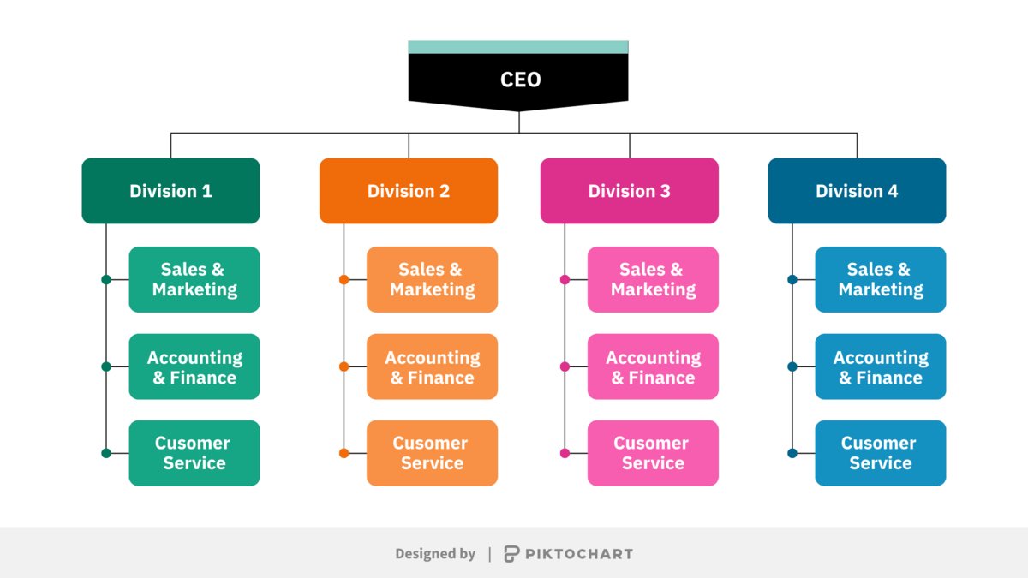

WHO ARE THE END USERS?

Slide 7

OUR SOLUTION AND ITS VALUE PROPOSITION
FILTERING:
It is used to identify the missing elements.
2. FORMULA :
It is used to remove the unwanted elements.
3.GRAPH:
It is used to represent the data visualization.
4.CONDITIONAL FORMATTING:
It is used identify he missing elements.

Slide 8
Dataset Description
This description is about employee data analysis which is done through data. It as 26 total features and in this data set it has involved 6 feature which includes;
Employee ID
Name
Gender
Department
Salary
Employee Type.

Slide 9

THE "WOW" IN OUR SOLUTION
PERFORMANCE LEVEL
=IFS(Z8>=5, “VERY HIGH”,Z8>=4,”HIGH”,
Z8>=3,”MED”,TRUE,”LOW”)
3/21/2024 Annual Review
9

Slide 10
MODELLING
Employee data modelling involves creating a structured representation of employee-related data to track, manage and analyze workforce information. Here’s a summary of the key components and processes involved:
1. DATA COILLECTION AND SOURCES
2. DASTA RELATIONSHIPS AND STRUCTURES
3.DATA MODELLING APPROACHES
4. TOOLS AND TECHNIQUES
5.DATA ANALYSIS AND REPORTING
6. DATA INTEGRITY AND SECURITY
This model helps organizations manage their human resources effectively by centralizing employee data for improved decision-making ,reporting, and compliance.
10

Slide 11
RESULTS
11

Slide 12
conclusion
Summary of Employee Data Analysis
The employee data analysis was conducted to evaluate various aspects of the workforce , including demographics, performance metrics, turnover rates, and employee satisfaction . The primary goals were to identify trends, potential areas for improvement, and to develop actionable insights to enhance organizational effectiveness.

